Slide 1
Introduction
Pulse Rate Monitor

Slide 2
APPROACH
Establishing objectives
Organize knowledge
Collect requirements
Create/Make reliable products.
Problems to be solved:
To be able to read human heart rate/pulse rate efficiently.
Goal prioritizing:
Ability to collect human pulse data, read it and display to user.
Domain knowledge filtering.
Homes, health care centers, gyms.
Domain requirements
Device must be made with harmless materials.
Develop and launch new software and user interface
It is quite obvious that with time technology evolves and we will too.

Slide 3
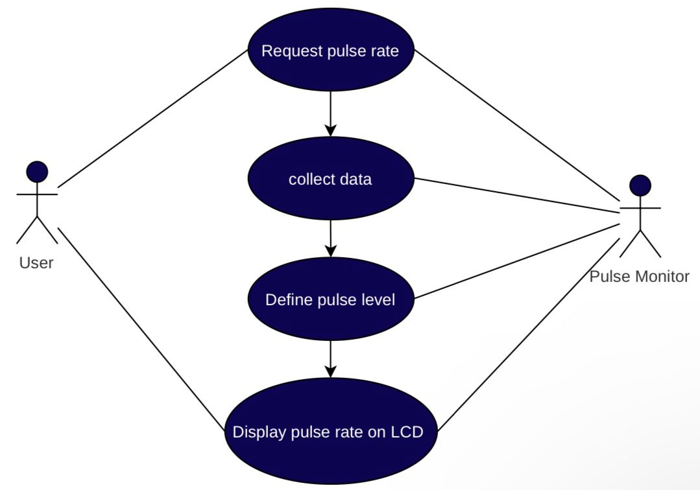
USE CASE DIAGRAMS
Establishing objectives
Organize knowledge
Collect requirements

Slide 4
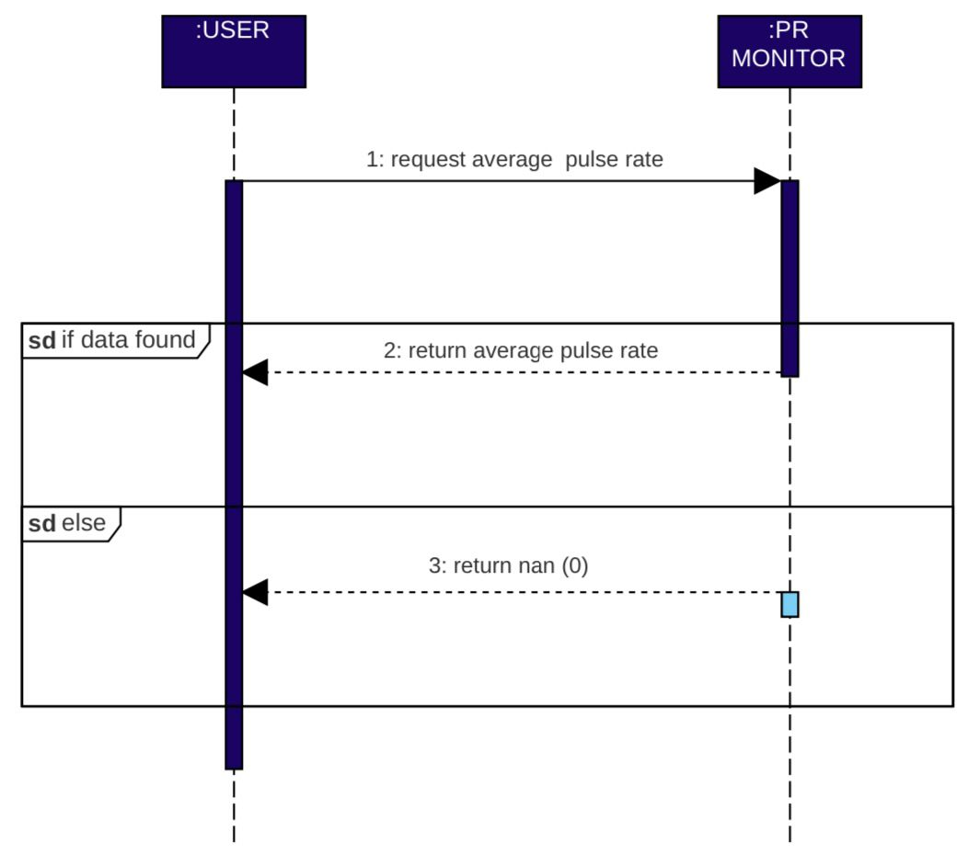
SEQUENCE DIAGRAMS
Foundation of trust
Near Future Aims

Slide 5
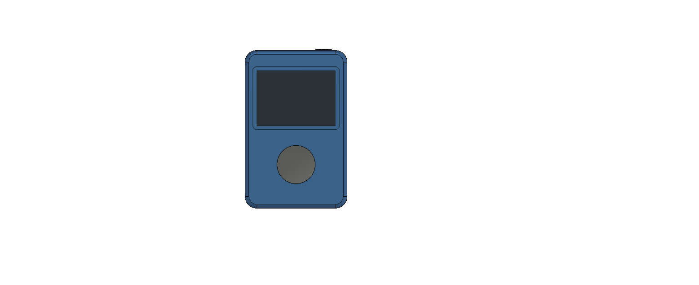
PROTOTYPE
DESIGN
Power button
LCD screen
Pulse sensor
Charging port

Slide 6
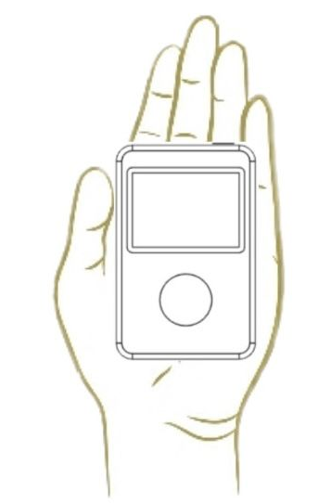
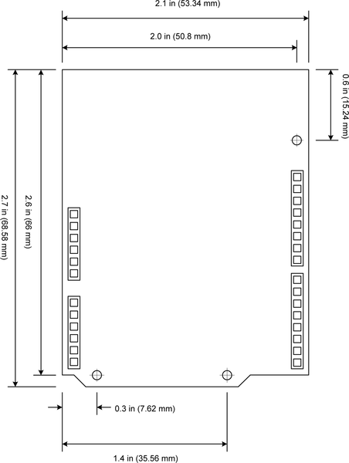
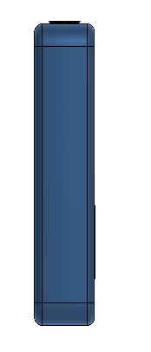
PROTOTYPE
DESIGN
85.399mm
57,00mm
20,00mm
Device Size

Slide 7
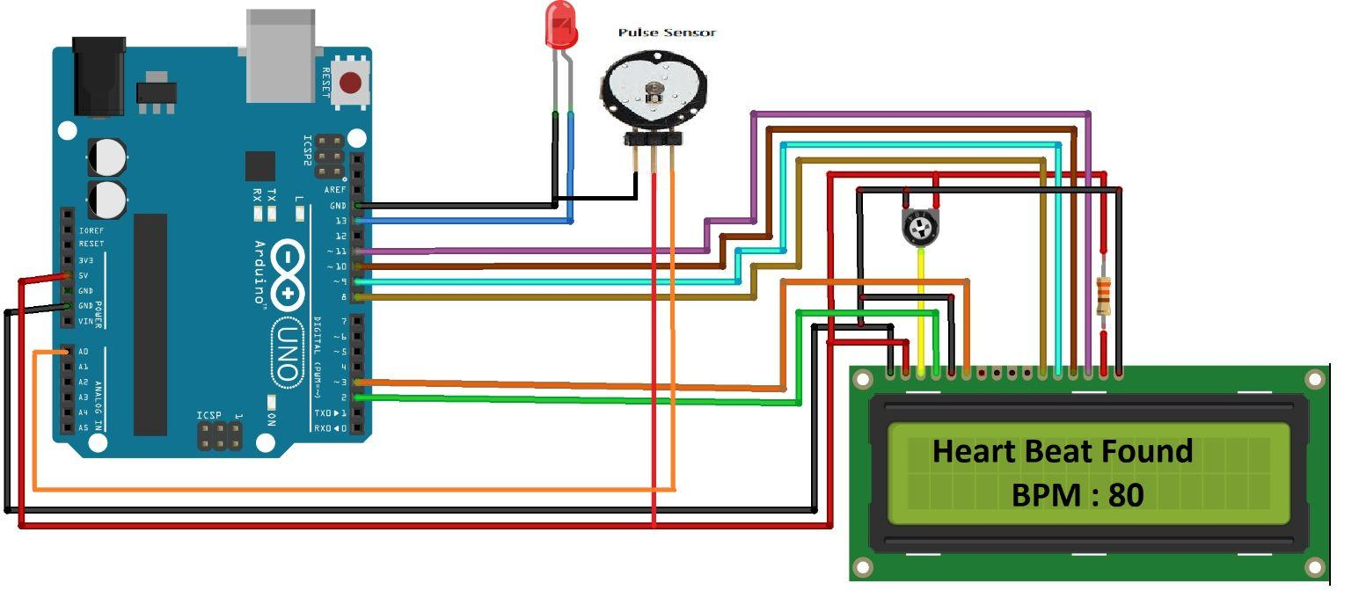
CIRCUIT DESIGN

Slide 8
DESIGN SIMULATION
HARDWARE SIMULATION

